Slide 1
Steamroller
Problem Statement title: STEAMROLLER: Multi-Agent ASR for Stuttered Speech
Theme/Domain : Speech & Language Processing using AI Agents
PS Category: Software
Team Leader Name: Aditya Suryakar
Video Link :

Slide 2
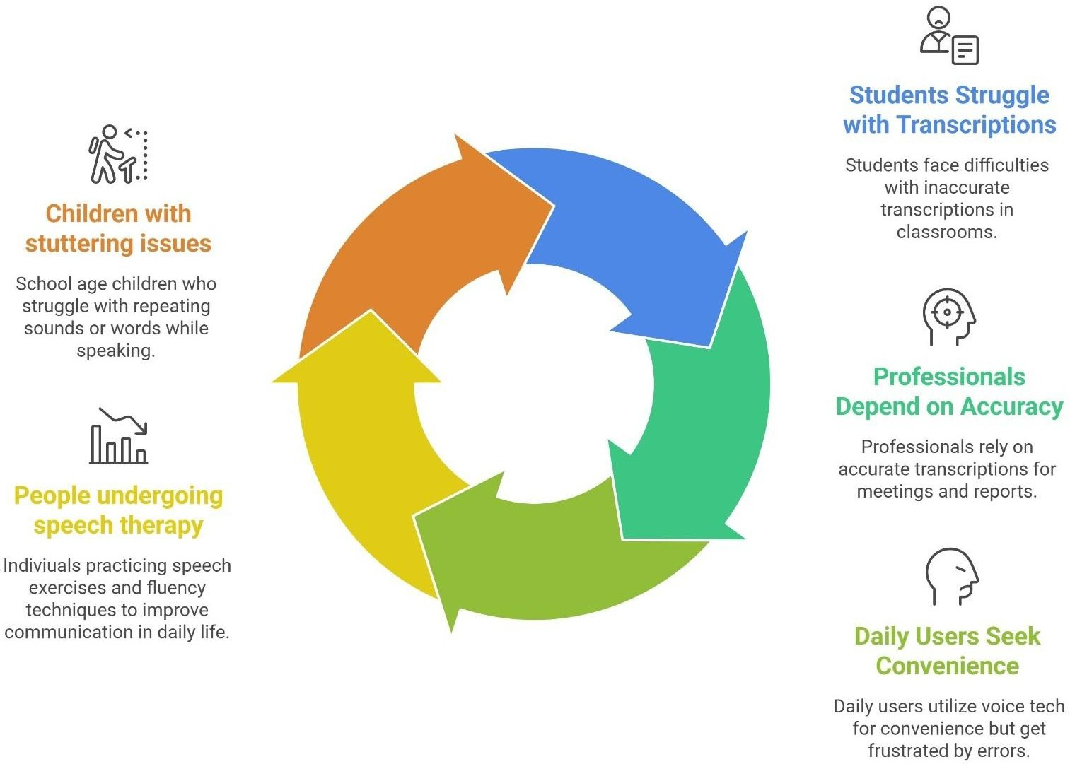
Problem Statement
Design and develop a real-time, multi-agent speech processing system that converts stuttered speech into fluent, semantically accurate text and speech output to improve accessibility for people who stutter.
Over 80 million people worldwide stutter, yet every mainstream ASR system is built exclusively for fluent speech - making them structurally incapable of handling repetitions, prolongations, and blocks. While workarounds exist, none offer real- time correction while preserving the speaker's natural voice and original meaning simultaneously.
Target Audience Segments
How the solution addresses the problem ?
Improves Speech Clarity : Converts stuttered speech into clear and fluent text or voice using AI.
Enhances Accessibility : Enables people who stutter to use voice- based technologies easily.
Boosts Confidence : Helps users communicate without fear or hesitation.
Promotes Digital Equity : Ensures equal access to education, jobs, and communication in a voice-first world.

Slide 3
Objectives
Audio Data Preprocessing : To design and implement a noise-robust audio preprocessing module that enhances input speech quality by reducing background noise, normalizing audio signals, and preparing the data for accurate speech recognition in real-world environments.
Repair Agents Creation : To develop multiple context-aware NLP-based repair agents (such as grammar correction, fluency enhancement, sequence correction, and stutter removal agents) that process transcribed text and generate improved, semantically meaningful outputs.
Master Agent Operation with Feedback Loop : To design a master agent that evaluates outputs from different repair agents using defined scoring metrics (semantic similarity, grammar, fluency, etc.), selects the best result, and incorporates a feedback loop mechanism to reprocess text when quality thresholds are not met.
Accuracy and Low Latency : To implement an advanced text-to-speech module capable of synthesizing natural, fluent, and stutter-free speech while preserving the original speaker's voice characteristics using voice cloning techniques.
Real-Time Input–Output Processing : To build a real-time speech processing pipeline that captures live audio input, performs speech-to-text conversion, applies intelligent text repair, and generates fluent audio output with minimal latency for seamless communication.

Slide 4
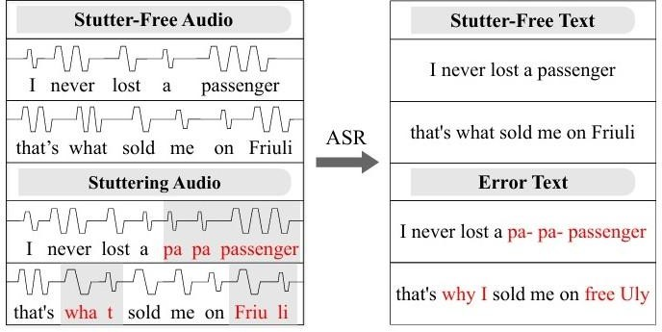
Solution
STEAMROLLER is a real-time system that converts stuttered speech into fluent and clear speech using a 5 stages pipeline: ASR Module, NLP Processing, Multi-Agent Text Repair, Master Agent Evaluation and Text-to-Speech with Voice Cloning
How it solves the problem ?
Output Comparison: Fluent vs Stuttered Speech
Speech-to-Text (ASR Module): Converts stuttered audio into an initial text transcript, capturing spoken content despite errors
NLP Processing: Prepares the text by converting it into token sequences for effective correction
Multi-Agent Text Repair: Multiple agents remove repetitions, fix grammar, and preserve the original meaning
Master Agent Evaluation: Selects and refines the best corrected output through feedback and validation
Text-to-Speech with Voice Cloning: Generates fluent, natural
speech while maintaining the speaker’s voice characteristics
Unique Features :
  Real-Time Speech Repair
  Meaning Preservation
  Personalized Voice Reconstruction
  End-to-End Speech Repair Pipeline

Slide 5
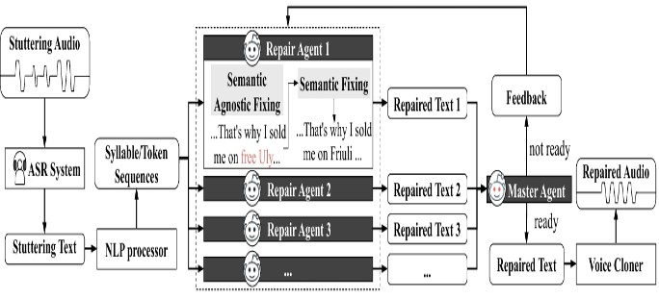




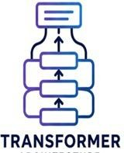






Technical Approach
Techstack
Streamlit
Python
Fast API
Tokenizer

Slide 6
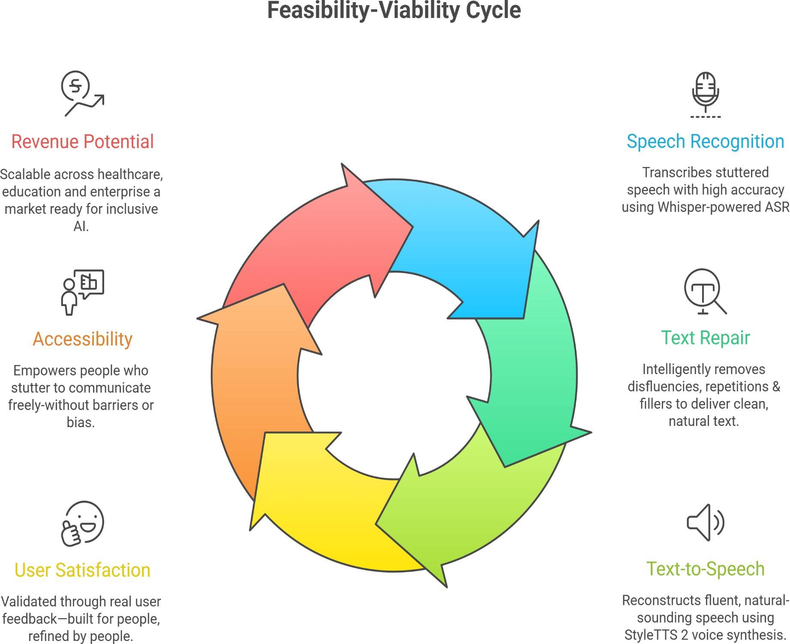
Feasibility
Uses existing technologies: ASR, LLM-based text repair, and Text-to-Speech
Modular pipeline (speech → text → repair → speech) makes
implementation easier
Proven improvements: reduced WER, better semantic accuracy, high user satisfaction
Real-time processing possible
Requires high computational power (GPU, APIs) and latency optimization
Dependent on ASR accuracy for best performance
Viability
Solves a major accessibility issue for people who stutter (large global need)Increasing demand with rise of voice assistants & remote communication
Multiple applications: meetings, interviews, call centers, assistive tools
Revenue potential: SaaS model, enterprise integrations, healthcare sector
Competitive advantage: end-to-end solution (repair + synthesis, not just detection)Scalable to other speech disorders and multilingual systems

Slide 7
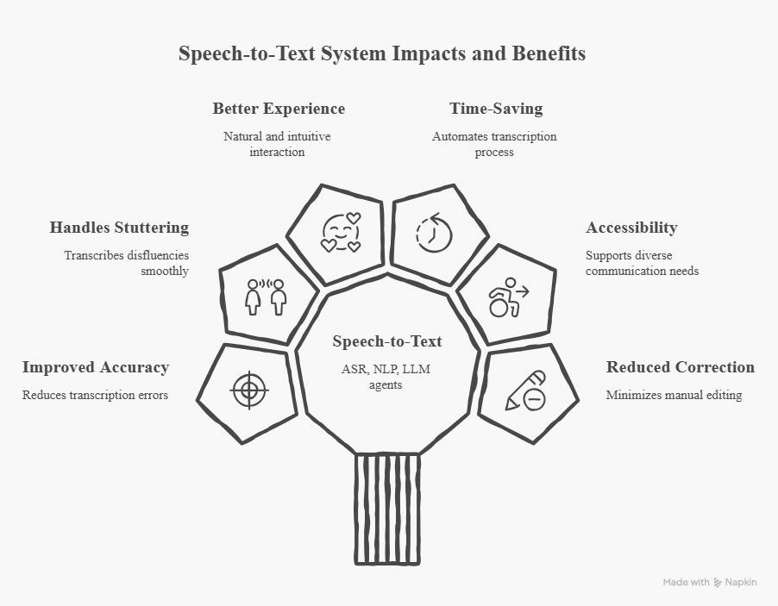
Impacts
Improves speech accessibility - converts spoken words into accurate text for everyone.
Handles real-world speech issues - corrects stuttering, repetitions, and mispronunciations.
Enhances user communication - ensures commands or messages are understood by machines accurately.
Reduces human intervention - minimizes the need to manually correct ASR errors.
Supports natural interaction - users can speak naturally without worrying about misrecognition.
Benefits
Time saving - users don’t have to repeat themselves or edit text
manually.
Improved accuracy - higher precision in speech-to-text
conversion.
Better user experience - fluid, understandable responses from the system.
Scalable solution - can be applied in voice assistants, transcription, accessibility tools.
Adaptive learning - system improves over time with multi-agent repair and LLM enhancements.

Slide 8

Research and References
Z. Xu, Y. Liu, Y. Li, L. Shi, K. Wang, and Y. Zhao, "STEAMROLLER: A multi-agent system for inclusive automatic speech recognition for people who stutter" arXiv preprint, arXiv:2601.10223, Jan. 2026. https://arxiv.org/abs/2601.10223
A. Radford, J. W. Kim, T. Xu, G. Brockman, C. McLeavey, and I. Sutskever, "Robust speech recognition via large-scale weak supervision," in Proc. 40th Int. Conf. Mach. Learn. (ICML), 2023, pp. 28492–28518. https://proceedings.mlr.press/v202/radford23a.html
Y. A. Li, C. Han, V. Raghavan, G. Mischler, and N. Mesgarani, "StyleTTS 2: Towards human-level text-to- speech through style diffusion," in Adv. Neural Inf. Process. Syst. (NeurIPS), vol. 36, 2023, pp. 19594–19621. https://proceedings.neurips.cc/paper_files/paper/2023/hash/3eaad2a0b62b5ed7a2e66c2188bb1449-Abstract-
Conference.html
N. B. Ratner and B. MacWhinney, "FluencyBank: A new resource for fluency research and practice," J. Fluency Disord., vol. 56, pp. 69–80, 2018. https://www.sciencedirect.com/science/article/abs/pii/S0094730X17300931
N. Reimers and I. Gurevych, "Sentence-BERT: Sentence embeddings using Siamese BERT-networks," in Proc. 2019 Conf. Empirical Methods Natural Lang. Process. (EMNLP), 2019, pp. 3982–3992. https://aclanthology.org/D19-1410/

